Slide 1
AP Art: 2D Design Portfolio
Jonathan Rutchik
Grade 11

Slide 2
Concentration
The concentration portion of the AP portfolio is a series of works that demonstrate a commitment to the thoughtful investigation of a specific visual idea. To document your process, you should present a number of conceptually identical works that show your growth and discovery. These works should use the principles of design in an informed and/or experimental way.

Slide 3
MY CONCENTRATION STATEMENT
In my concentration I sought to capture the effect that lighting has on being a crucial factor in creating a photograph. In some of my works I included the light source directly in the picture, while in other works the light source remained outside of the image. Whether the light was visible or not, it did a great deal in helping to create my concentration photographs.

Slide 4
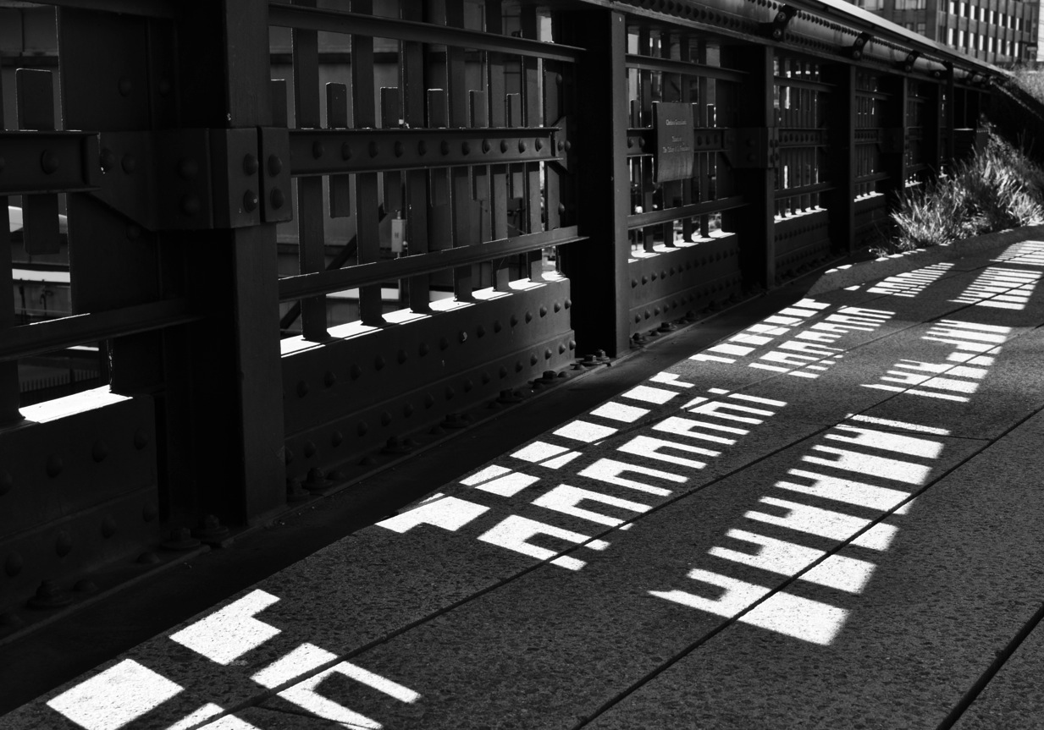
Fence From the Highline digital photography 7”x10”

Slide 5
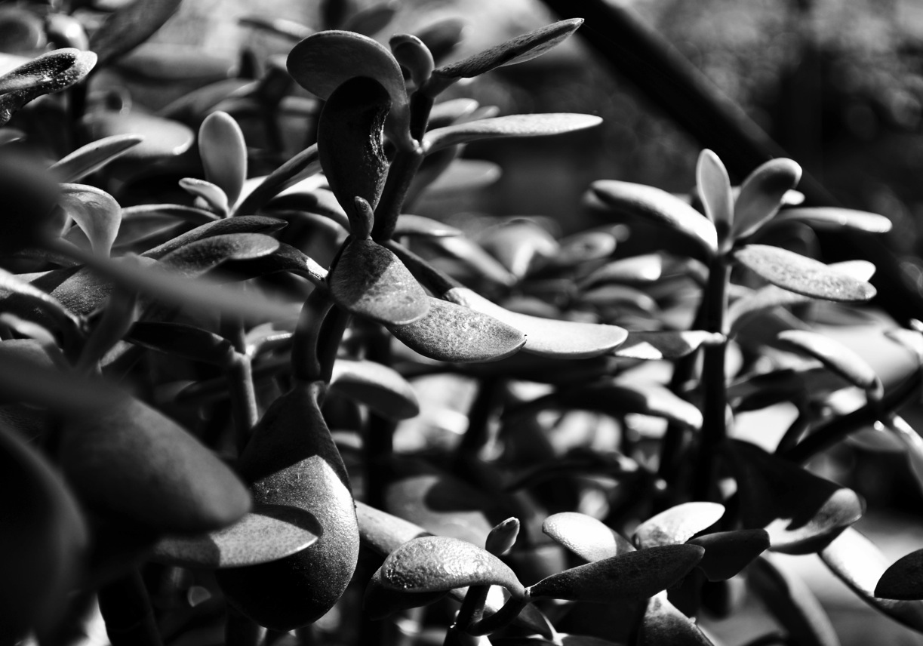
Big Grass digital photography 7”x10”

Slide 6
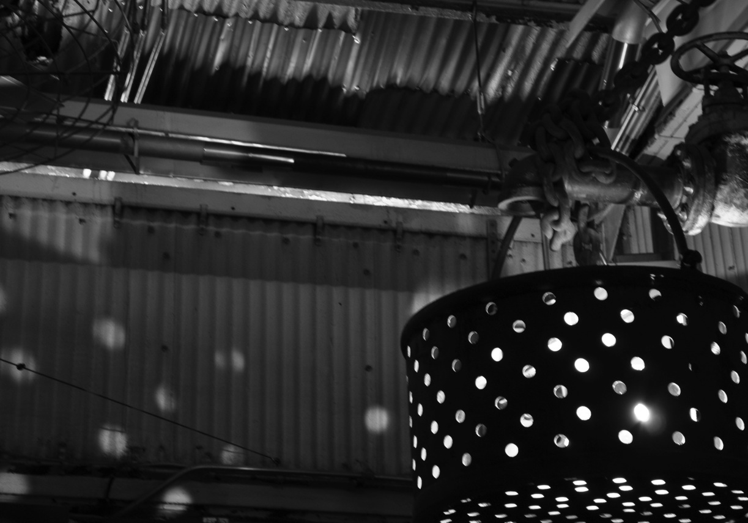
Chelsea Market digital photography 7”x10”

Slide 7
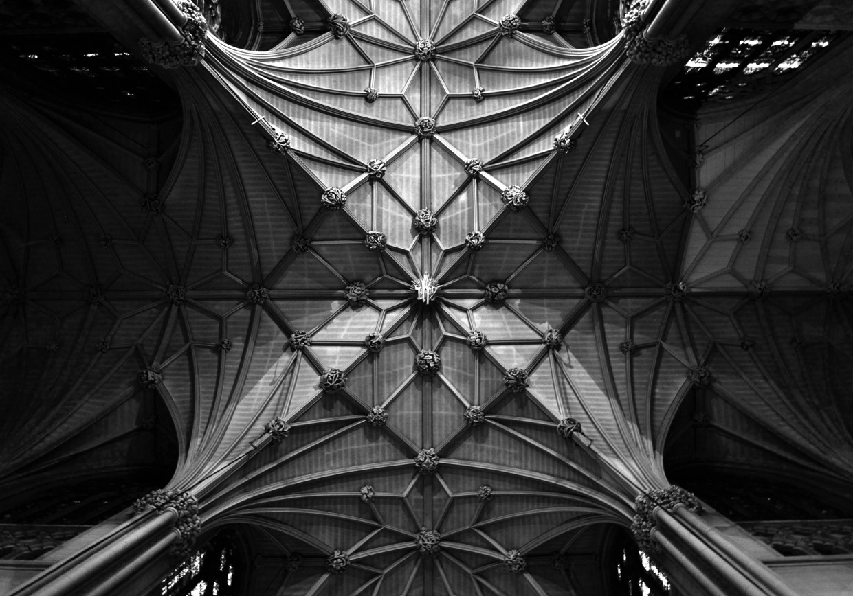
St. Patrick’s digital photography 7”x10”

Slide 8
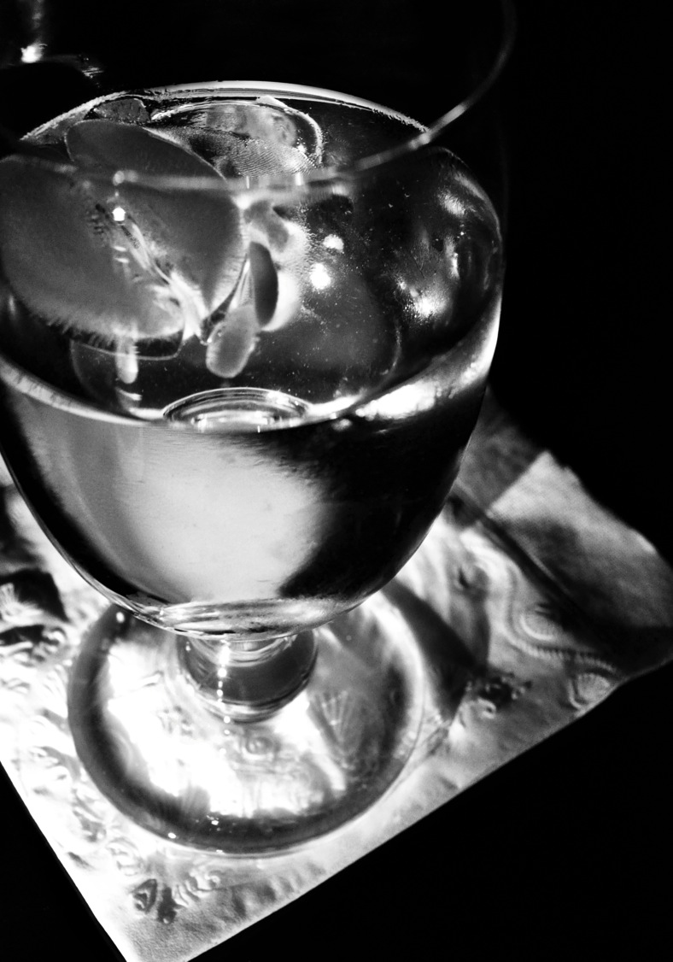
The Sweating Glass digital photography 10”x7”

Slide 9
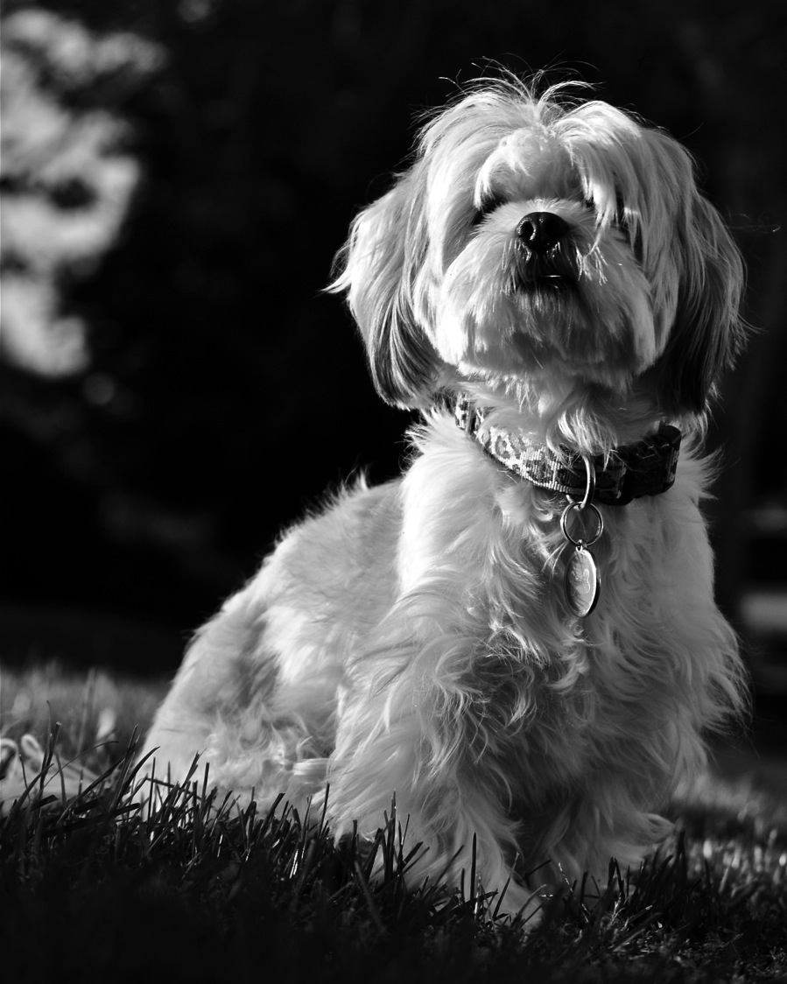
Mia digital photography 10”x7”

Slide 10
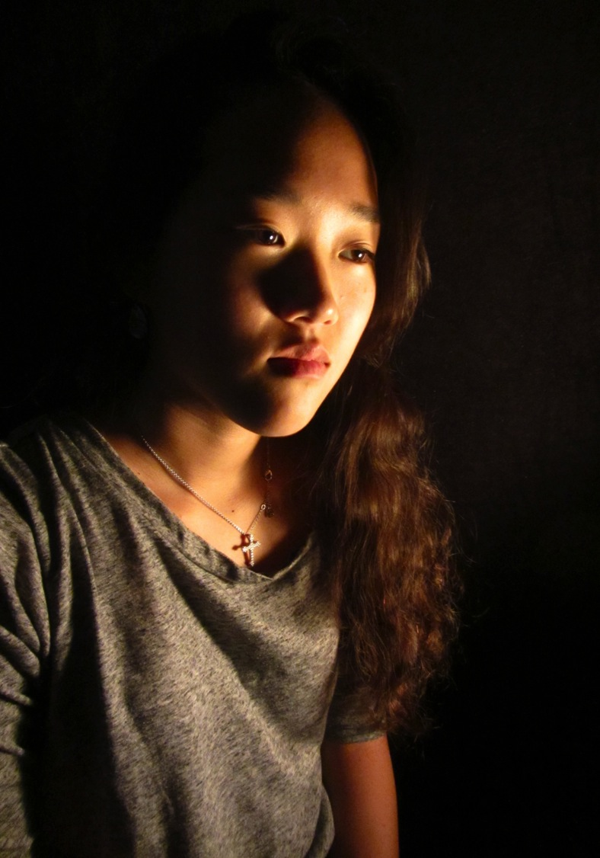
Rachel digital photography 10”x7”

Slide 11
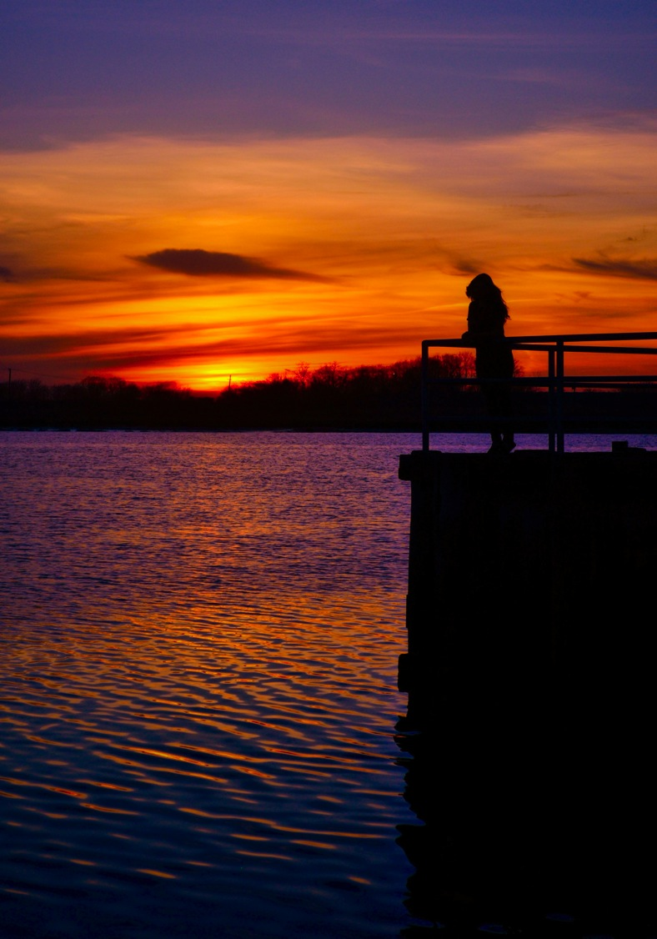
Orange Tones & Blue Tones digital photography 10”x7”

Slide 12
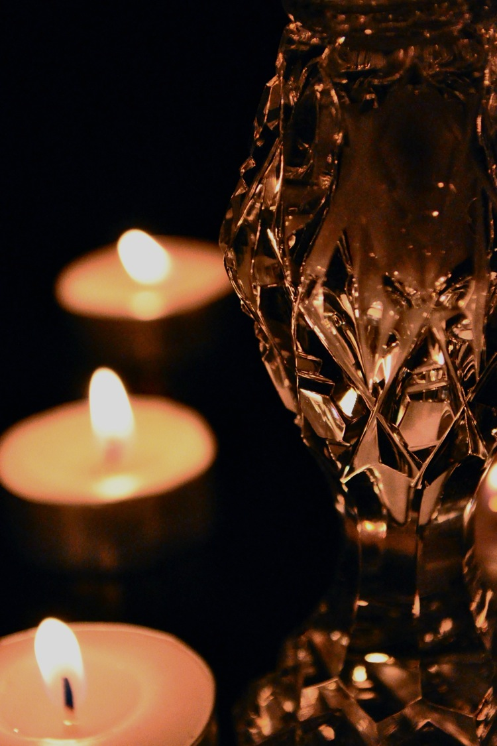
Crystal Salt Shaker Accented By Tea Lamps digital photography 10”x7”

Slide 13
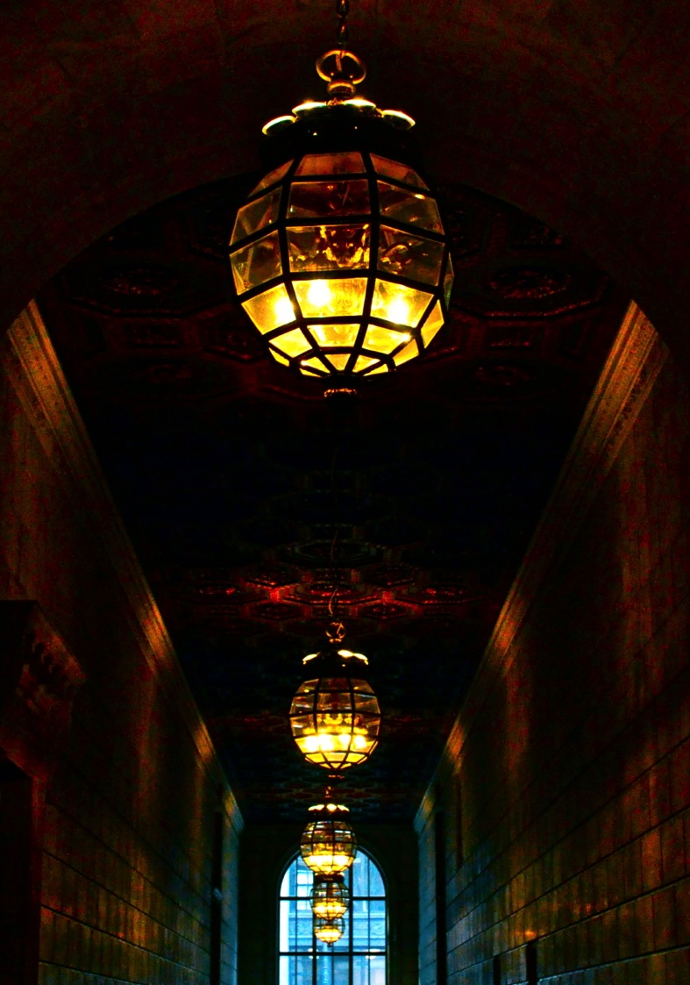
Blue Light Coming From A Long Dark Hallway With A Tall Window At The End digital photography 10”x7”

Slide 14
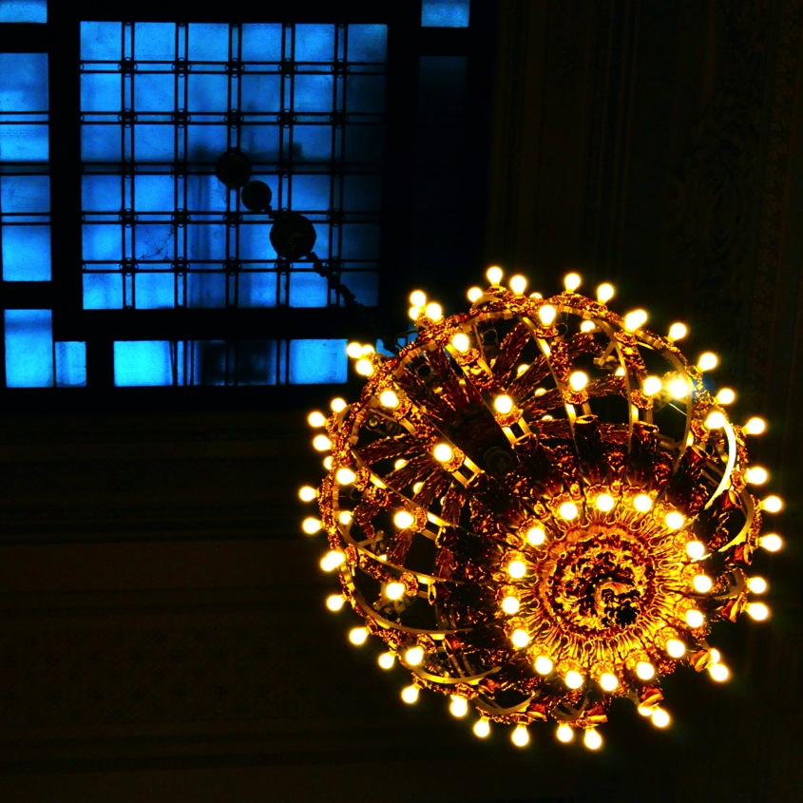
Another Blue Light Emerging From A Blue Window digital photography 7”x7”

Slide 15
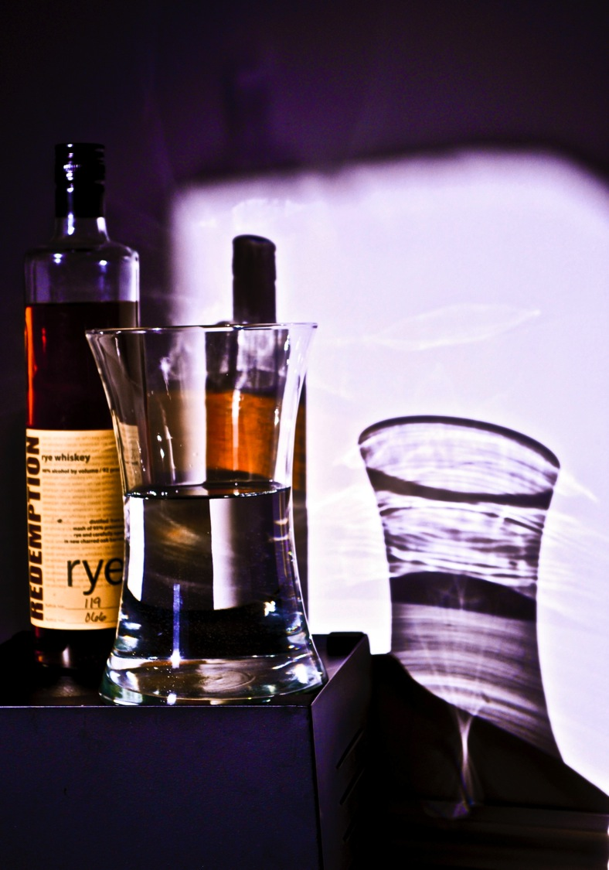
Old Vintage Brown-ish Tint digital photography 10”x7”

Slide 16
BREADTH
In this section, the artworks submitted should demonstrate your understanding of the principals of 2D design. Include examples of unity/variety, balance, emphasis, contrast, rhythm, repetition, proportion/scale and figure/ground relationship in the breadth section. You must demonstrate that you are thoughtfully applying these principals while creating your art.

Slide 17
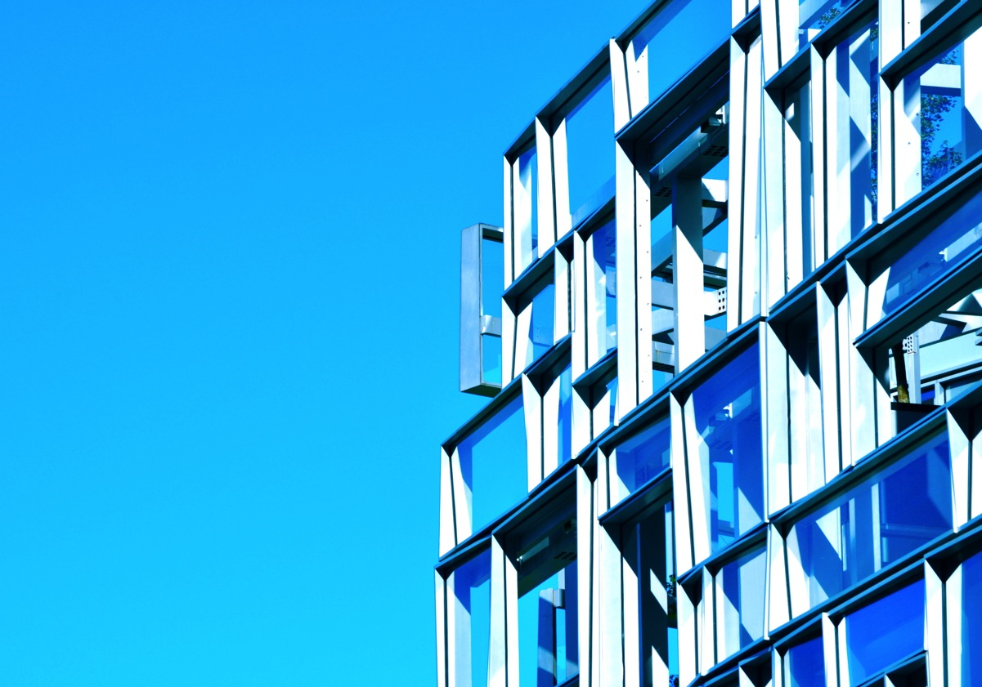
Blue digital photography 7”x10”

Slide 18
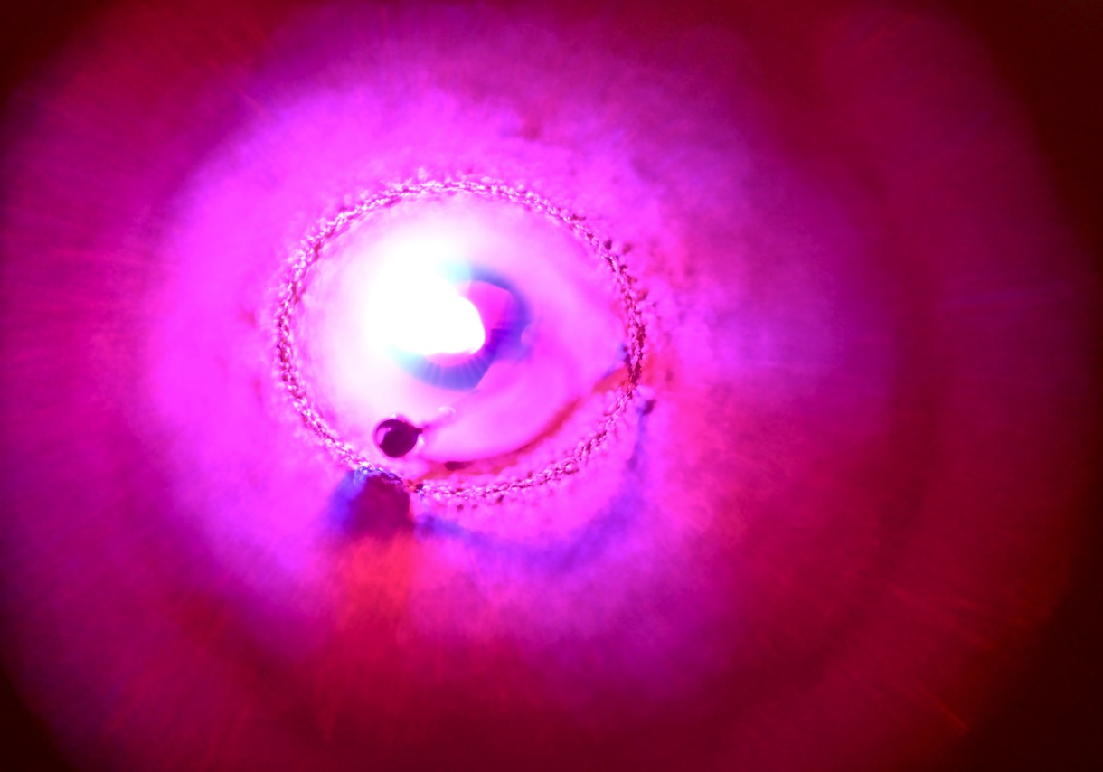
Pink Light digital photography 7”x10”

Slide 19
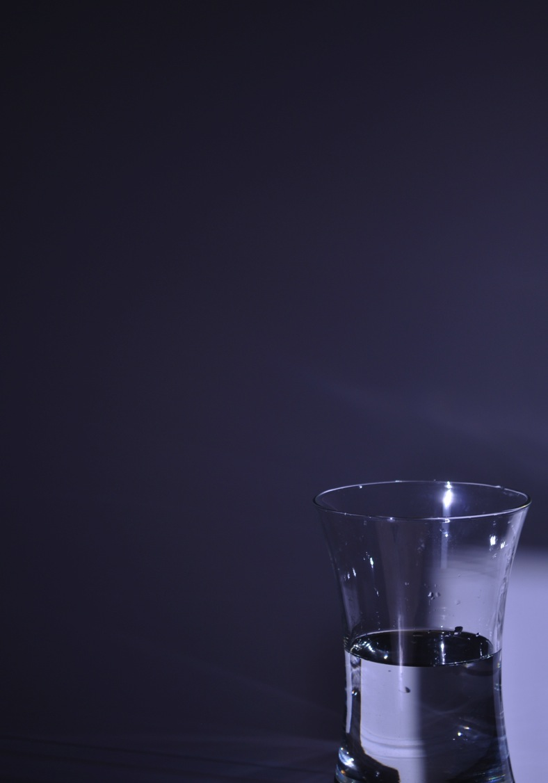
Jug digital photography 10”x7”

Slide 20
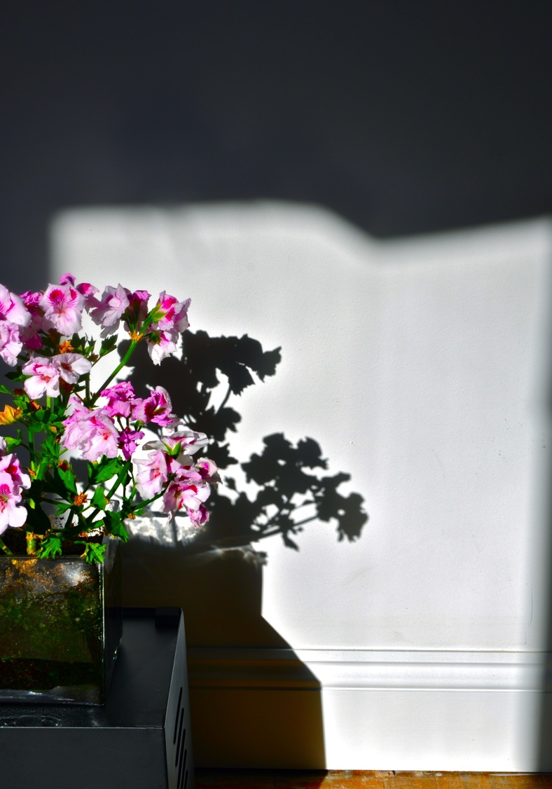
Flowers Against A White Wall digital photography 10”x7”

Slide 21
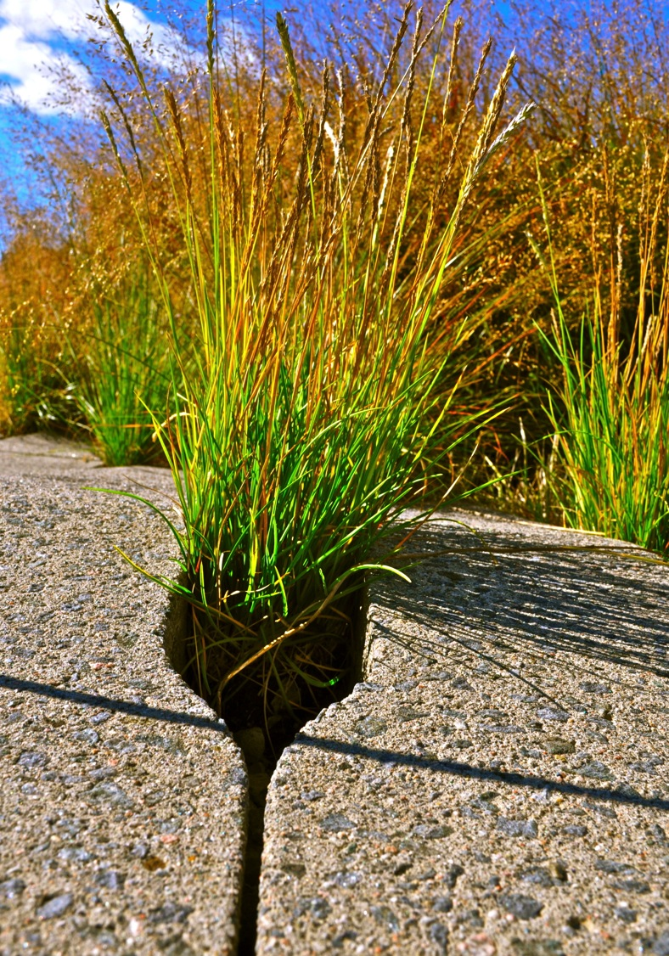
Sharp Grass digital photography 10”x7”

Slide 22
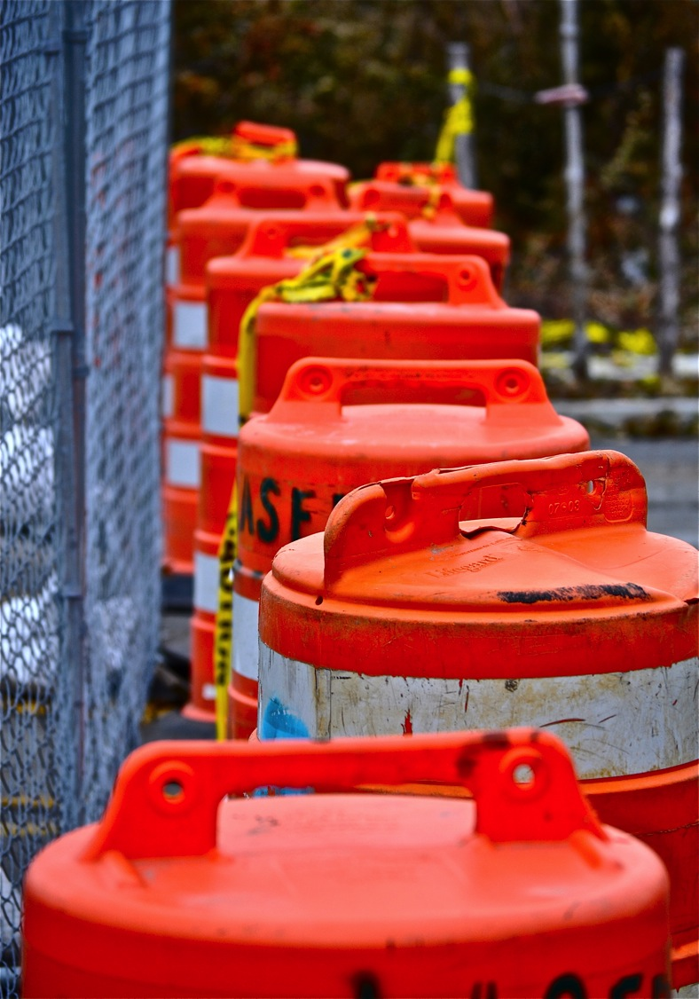
Closed Road Ahead digital photography 10”x7”

Slide 23
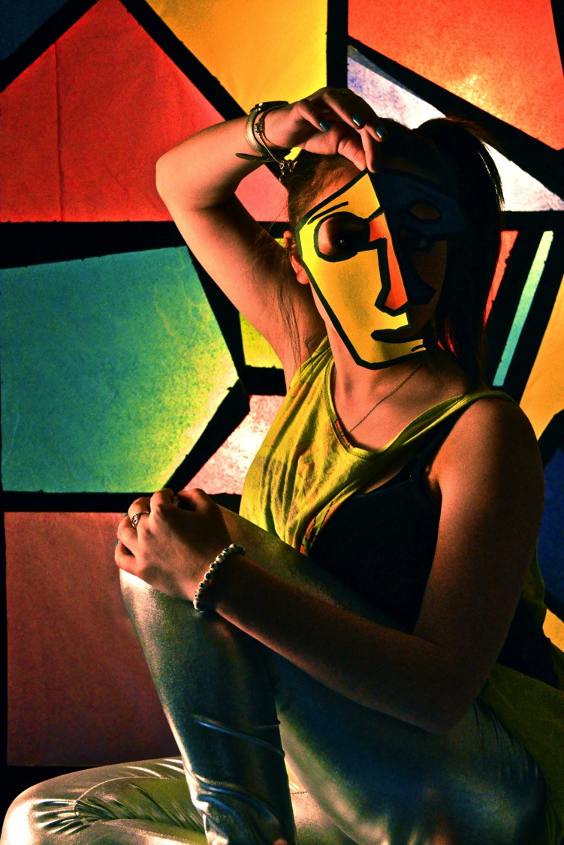
Have A Little Faythe digital photography 10”x7”

Slide 24
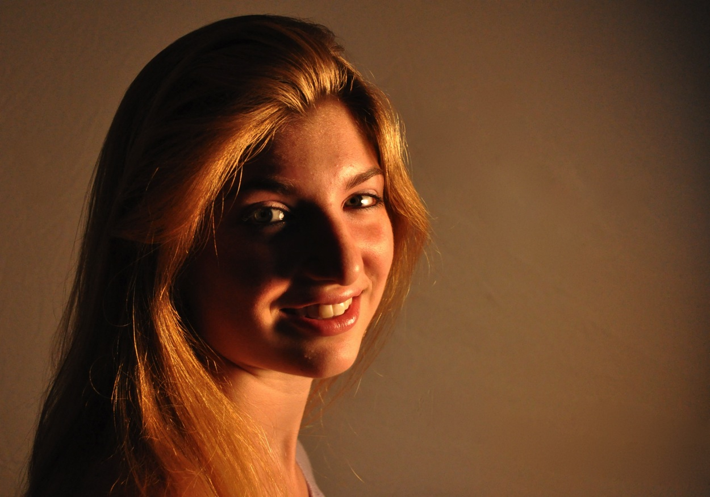
Girl In Warm Light digital photography 7”x10”

Slide 25
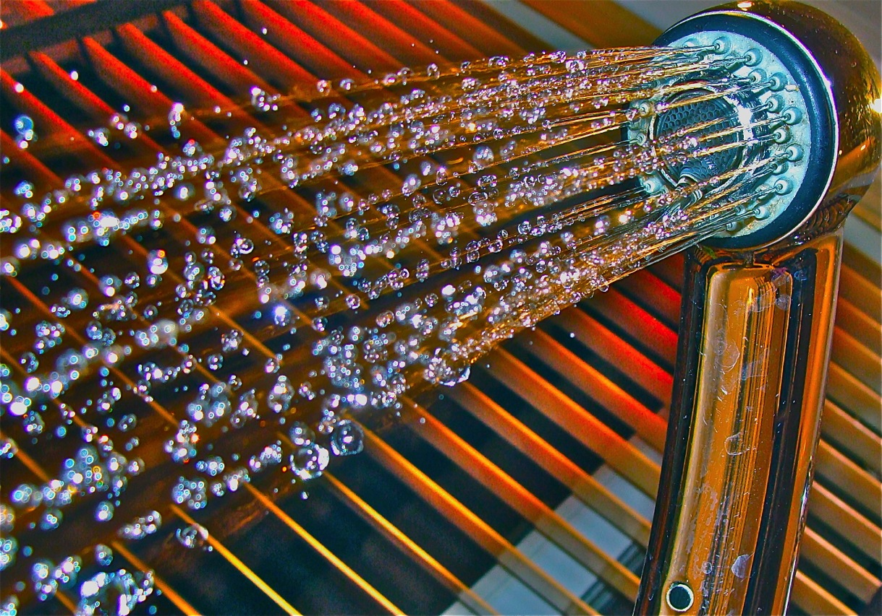
Let It Rain digital photography 7”x10”

Slide 26
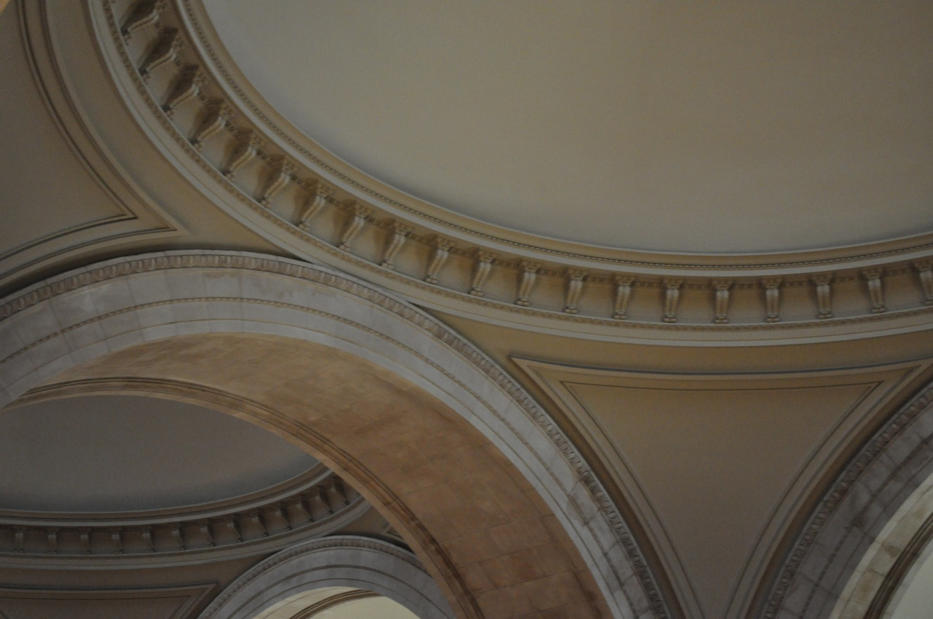
The Metropolitan Circles digital photography 7”x10”

Slide 27
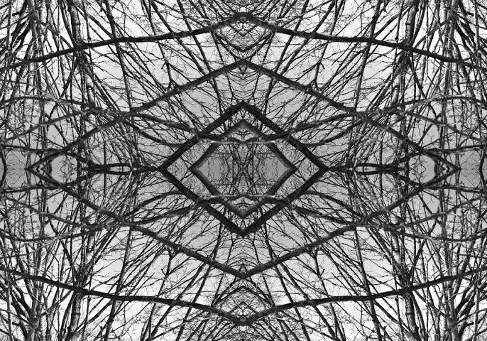
A Tree Times Four digital photography 7”x10”

Slide 28
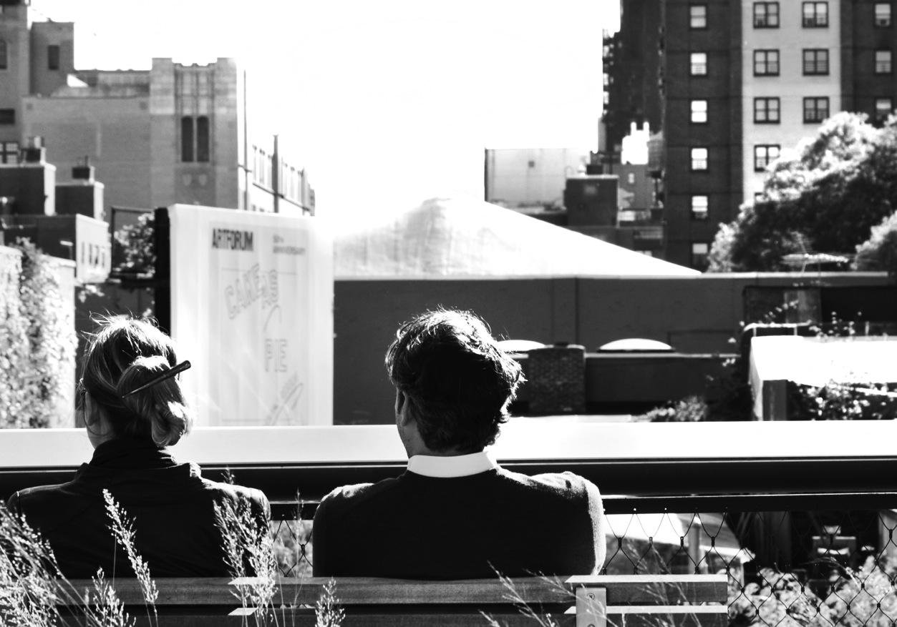
The Highline Relationship digital photography 7”x10”

